Slide 1


TANGO GATOR-SAT Project
System Design Review
Naomi Camargo, Shadalou Fernandez, Andre Hada, Nicholas Hirsh, Nicholas Kottas, Dhruv Mathuria, Nishtha Rajani, Noah Touchton, Ian Truelsegaard
University of Florida – EAS4700 - October 9th, 2025

Slide 2

Communications
Noah Touchton

Slide 3
System Overview
One onboard computer in the main satellite manages data handling, with a 64GB eMMC for buffering payload data prior to downlink.
The communication system has dedicated subsystems for downlink, telemetry and command, and inter-sat links.
Data Handling
Controlled by STM32H723VET6 microcontroller.
Buffered on a SDINBDG4-64G-ZA3 eMMC.
Payload Downlink
Using S-Band frequency.
Sent by AAC-Clyde PULSAR-STX transmitter and ISISPACE S-Band Patch Antenna.
Telemetry & Command
Uses GomSpace AX100 S-Band transceiver and S-Band TT&C antenna to receive commands from the ground.
Inter-Sat Communication
Uses Sub-GHz ISM
Uses Semtech SX1262 modules and AAC ANT-100 Static Whip to communicate between satellites.
10/09/25
Noah Touchton – ntouchton@ufl.edu
TANGO SDR​ - UF

Slide 4
Requirements
Standard | Source | Name | Description | Supported By | Status
ASD-GTRS-020 | EAS 4700 Project Requirements | Communication System Capability | he GATOR-SAT SmallSat shall be able to receive commands and transmit image, health, and status data directly to Earth ground stations within sight of the spacecraft along its orbital path. | The S-Band antenna and transmitter
ASD-GTRS-018 | EAS 4700 Project Requirements | Maximum Mission Duration | The GATOR-SAT SmallSat shall have sufficient fuel to support observation operations and maintain the orbit for six months, not including transit time to/from the target orbit for the initial proof-of-concept mission.
10/09/25
Noah Touchton – ntouchton@ufl.edu
TANGO SDR​ - UF

Slide 5
Derived Requirements
Standard | Source | Name | Description | Supported By | Status
COM-GTRS-01 | ASD-GTRS-020 | Downlink Data System | The spacecraft shall provide access to payload and housekeeping data through a high-rate S-Band link. | Fairbanks/RBC Ground Stations, PULSAR-STX
COM-GTRS-02 | ASD-GTRS-020 | Data Buffering | The spacecraft shall store ≥7 days (≈2 GB) of data in case of missed passes. | STM32H723VET6 + 64 GB eMMC
COM-GTRS-03 | ASD-GTRS-020 | InterSat Crosslink Rate | The spacecraft shall support intersatellite communications at ≥100 kbps, enabling data relay and coordination. | PULSAR-STX + ISISPACE Patch Antenna
COM-GTRS-04 | ASD-GTRS-020 | TT&C Link | The spacecraft shall maintain a continuous S-Band TT&C link at ≥9.6 kbps for health/status telemetry and command reception. | PULSAR-STX, link budget margin
COM-GTRS-05 | COM-GTRS-01 | Daily Data Volume | The spacecraft shall downlink at least 288 MB per day to satisfy payload science return. | SX1262 transceivers + ANT-100 whips
10/09/25
Noah Touchton – ntouchton@ufl.edu
TANGO SDR​ - UF

Slide 6
Derived Requirements
Standard | Source | Name | Description | Supported By | Status
COM-GTRS-06 | COM-GTRS-01 | Downlink Rate | The S-Band transmitter shall support a downlink rate sufficient to clear the required 288 MB within available ground station passes , | PULSAR-STX
COM-GTRS-07 | COM-GTRS-01 | Ground Contact Utilization | The spacecraft shall transmit stored data during at least 2 ground station passes per day, leaving one additional pass margin. | AX100 transceiver
COM-GTRS-08 | ASD-GTRS-018 | Lifetime Operations | The communications subsystem shall maintain functional capability for at least six months without hardware degradation that prevents required data return. | All comms subsystem components, power/EPS margin.
COM-GTRS-09 | COM-GTRS-01 | Link Redundancy | The comms subsystem shall include two independent paths: a high-rate downlink (PULSAR-STX) and a low-rate TT&C fallback (AX100). | PULSAR-STX + AX100.
COM-GTRS-10 | COM-GTRS-01 | Frequency Allocation Compliance | The S-Band system shall operate strictly within the 2.0–2.3 GHz CubeSat allocation to ensure regulatory compliance. | S-Band tuning (2.0–2.3 GHz), ground station licensing.
10/09/25
Noah Touchton – ntouchton@ufl.edu
TANGO SDR​ - UF

Slide 7
Derived Requirements
Standard | Source | Name | Description | Supported By | Status
COM-GTRS-11 | COM-GTRS-01, COM-GTRS-04 | Antenna Configuration | The spacecraft shall use a nadir-facing S-Band patch antenna for Earth link and two omnidirectional whips for crosslinks. | ISISPACE Patch (nadir-facing) + ANT-100 whips.
COM-GTRS-12 | COM-GTRS-02 | Data Prioritization | The onboard C&DH system shall prioritize transmission of housekeeping + health data before payload data in the event of bandwidth limitations. | STM32 firmware logic.
COM-GTRS-13 | ASD-GTRS-020 | Data Formatting Standard | The spacecraft shall package payload and housekeeping data in a standardized frame structure (header, payload, checksum) so that ground stations can parse data consistently and in the correct sequence. | TM32 packetization firmware + ground software.
COM-GTRS-14 | ASD-GTRS-020 | Data Source Authentication | The spacecraft shall implement a method to verify that all uplinked commands originate from authorized ground stations, preventing unauthorized tampering. | AX100 transceiver, STM32 firmware (crypto/auth).
COM-GTRS-15 | ASD-GTRS-020 | Data Receipt Confirmation | The spacecraft shall support a positive acknowledgment protocol (ACK/NACK) to confirm that transmitted frames are received correctly by the ground system. | PULSAR-STX, AX100.
10/09/25
Noah Touchton – ntouchton@ufl.edu
TANGO SDR​ - UF

Slide 8
Derived Requirements
Standard | Source | Name | Description | Supported By | Status
COM-GTRS-16 | COM-GTRS-13 | Sequential Data Ordering | The spacecraft shall include frame counters or time tags in each transmission so the ground station can verify that data is received in the correct order without loss or duplication. | STM32 frame counters + ground station telemetry parser.
COM-GTRS-17 | COM-GTRS-02 | Data Storage | The spacecraft shall have enough onboard storage to store the buffered data. | 64GB eMMC
10/09/25
Noah Touchton – ntouchton@ufl.edu
TANGO SDR​ - UF

Slide 9
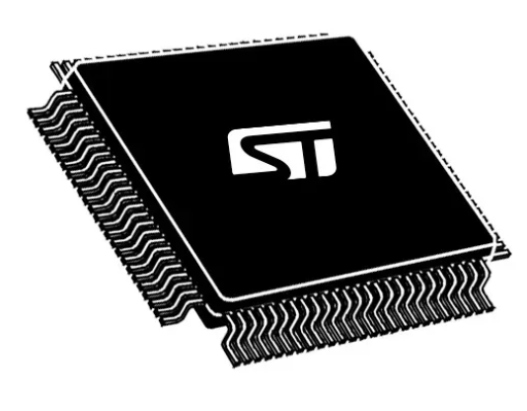
Microcontroller Trade Study
10/09/25
Noah Touchton – ntouchton@ufl.edu
TANGO SDR​ - UF

Slide 10
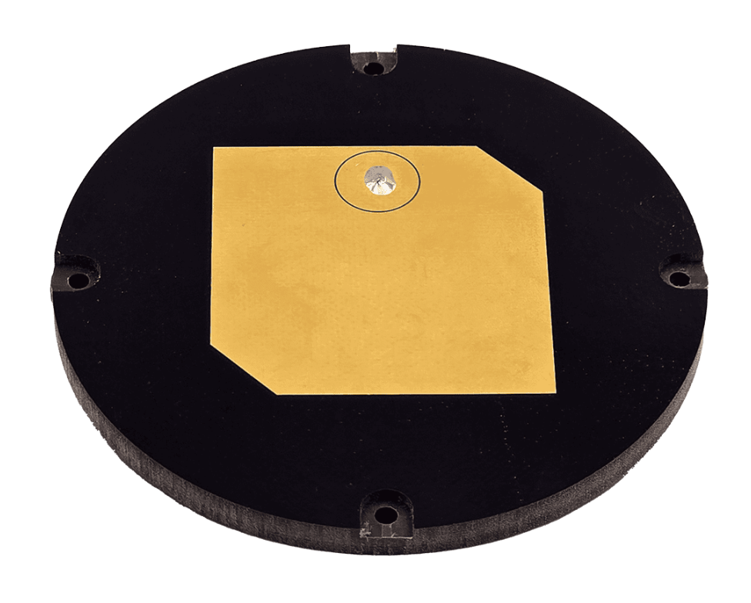
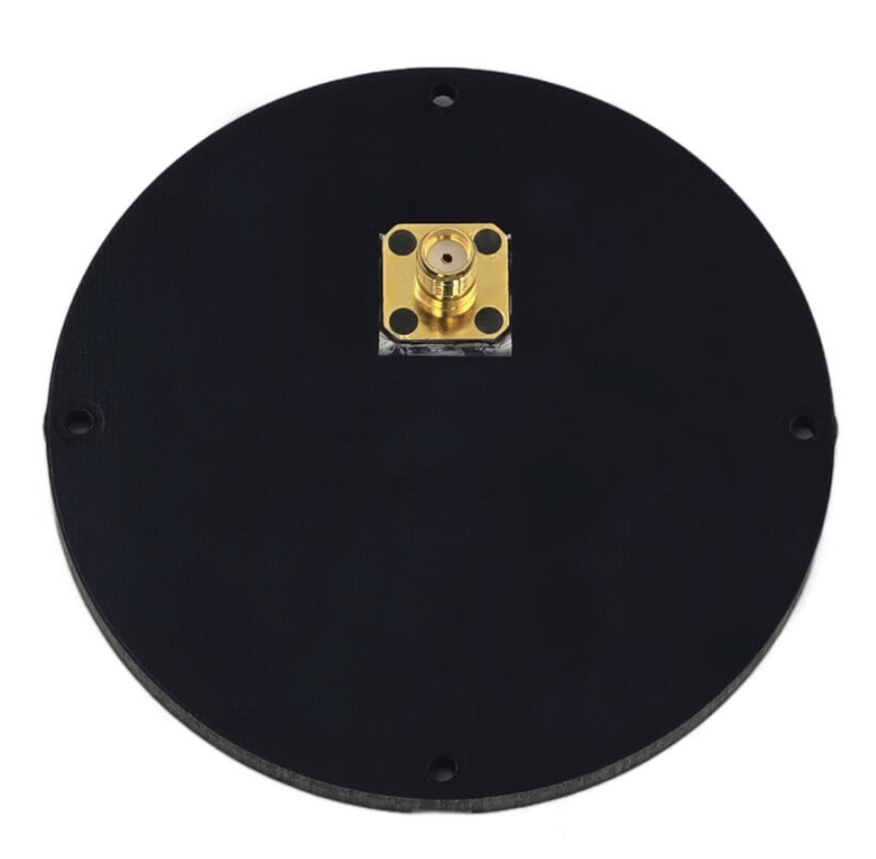
Downlink Antenna Trade Study
10/09/25
Noah Touchton – ntouchton@ufl.edu
TANGO SDR​ - UF

Slide 11
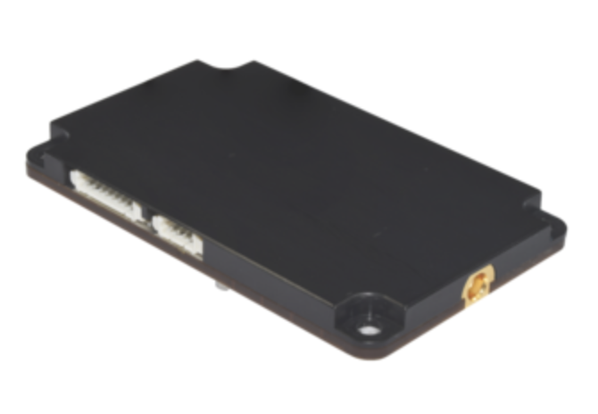
Transceiver Trade Study
10/09/25
Noah Touchton – ntouchton@ufl.edu
TANGO SDR​ - UF

Slide 12
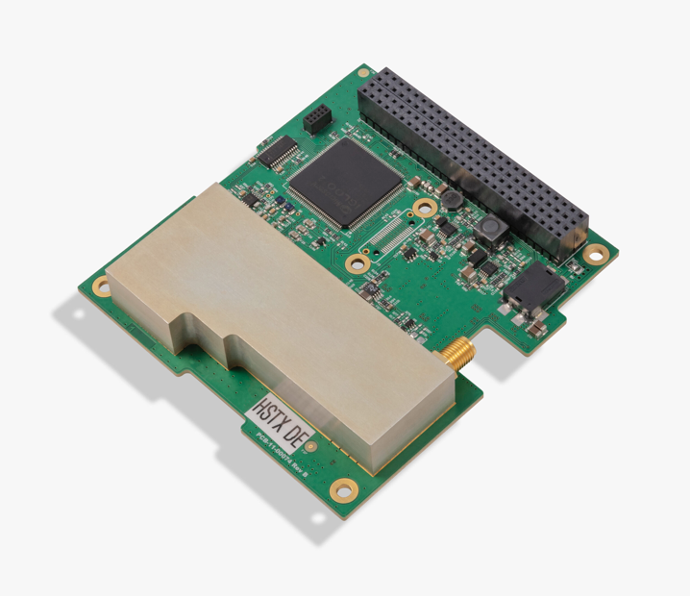
Transmitter Trade Study
10/09/25
Noah Touchton – ntouchton@ufl.edu
TANGO SDR​ - UF

Slide 13
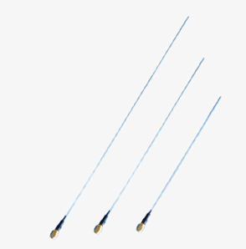
InterSat Antenna Trade Study
10/09/25
Noah Touchton – ntouchton@ufl.edu
TANGO SDR​ - UF

Slide 14
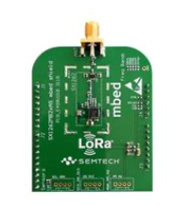
InterSat Transciever Trade Study
10/09/25
Noah Touchton – ntouchton@ufl.edu
TANGO SDR​ - UF

Slide 15
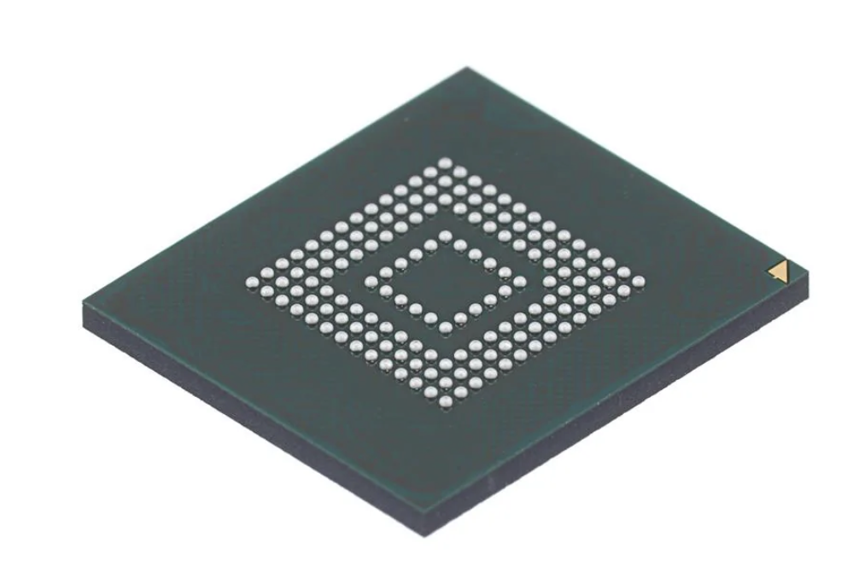
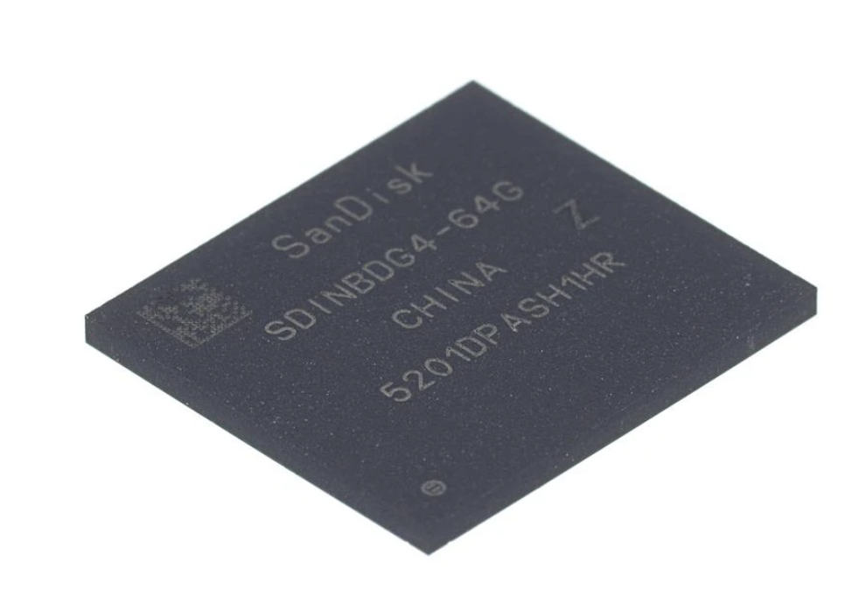
Data Storage Trade Study
10/09/25
Noah Touchton – ntouchton@ufl.edu
TANGO SDR​ - UF

Slide 16
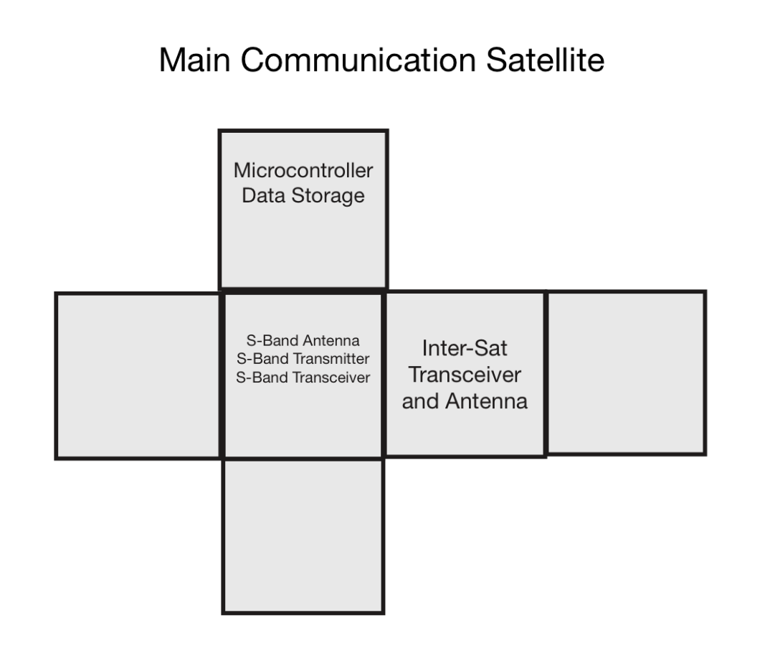
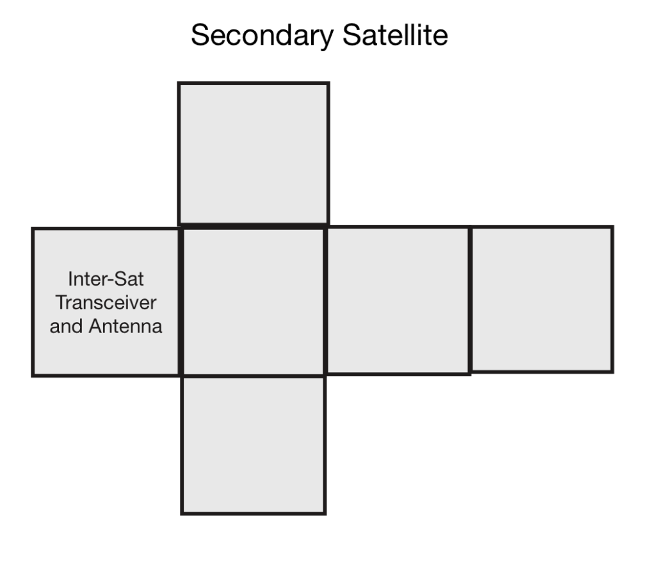
Component Placement
The main communication satellite will have one S-Band transceiver and one S-Band transmitter along side an antenna.
The main communication satellite will have the microcontroller alongside the data storage device.
Both satellites will have the InterSat transmitters and antennas to send data back and forth.
10/09/25
Noah Touchton – ntouchton@ufl.edu
TANGO SDR​ - UF

Slide 17
Ground Stations
Primary Station: RBC Fairbanks (S-Band), frequent LEO contacts
Coverage: 11 passes/day (orbit-dependent)
Pass Duration: 3–10 min typical
Data Return: ≥288 MB/day → achievable with 2 passes @ ≥500 kbps + 7-day buffer on eMMC
Operations:
Downlink: PULSAR-STX + Patch → Earth data
Uplink: AX100 → Receive authenticated commands
ACK/NACK and prioritization (housekeeping > payload)
Regulatory: Operates in 2.0–2.3 GHz CubeSat S-Band allocation
Risks & Mitigation:
Insufficient passes → secondary GS or compression
Scheduling conflicts → buffer + margin pass
Low-elevation losses → reduce rate / use higher elevation passes
10/09/25
Noah Touchton – ntouchton@ufl.edu
TANGO SDR​ - UF

Slide 18
Mass Budget
10/09/25
Noah Touchton – ntouchton@ufl.edu
TANGO SDR​ - UF

Slide 19
Power Budget
10/09/25
Noah Touchton – ntouchton@ufl.edu
TANGO SDR​ - UF

Slide 20
Risk Template
ID | Risk | L | S | Mitigation
1 | High-rate downlink transmitter (PULSAR-STX) failure results in no payload science data return. | 2 | 5 | Provide redundant TT&C link (AX100), schedule frequent downlinks, and prioritize housekeeping data.
2 | Ground station coverage insufficient to meet 288 MB/day downlink. | 1 | 4 | Use multiple ground stations, optimize compression, buffer ≥7 days of data.
3 | Intersat crosslink (SX1262) failure prevents coordination. | 3 | 3 | Design mission operations to tolerate single-sat autonomy, add margin with redundant antennas.
4 | Antenna deployment or orientation failure (patch/whips not radiating properly). | 3 | 4 | Qualification testing, deploy antennas with proven mechanisms, include dual whips for omni coverage.
5 | Onboard data storage (eMMC) corruption leading to science data loss. | 2 | 4 | Redundant partitioning, ECC checks, buffer multiple days, prioritize telemetry in downlink.
6 | Power budget exceeded during simultaneous TX events (PULSAR + AX100 + SX1262). | 2 | 3 | Schedule transmissions sequentially, verify power margins in FSW, provide load-shedding fallback.
LIKELIHOOD | 5
 | 4
 | 3 |  |  | 3 | 4
 | 2 |  |  | 6 | 5 | 1
 | 1 |  |  |  | 2
 |  | 1 | 2 | 3 | 4 | 5
 |  | SEVERITY
10/09/25
Noah Touchton – ntouchton@ufl.edu
TANGO SDR​ - UF

Slide 21
Road to PDR
Finalize Data Formatting Protocol
Define exact frame structure (headers, payload, checksum).
Ensure compatibility with ground station decoding.
Implement Command Authentication Scheme
Select encryption/authentication method (e.g., key-based).
Verify uplink commands cannot be spoofed.
Define ACK/NACK Confirmation Protocol
Establish positive acknowledgment logic.
Test retransmission process if data not received.
Sequential Data Ordering
Add frame counters or time tags to downlink packets.
Prevent data loss or duplication during long passes.
Link Budget Refinement
Double-check pass durations vs data rate margin.
Confirm that daily 288 MB is feasible under worst-case contact.
10/09/25
Noah Touchton – ntouchton@ufl.edu
TANGO SDR​ - UF

Slide 22
Backup Material (Communications)
Noah Touchton

Slide 23
OISR
Tracking ID​ | Description​ | Opened​ | Original ECD​ | Revised ECD​ | Trend​
COM-1​ | Component trade studies​ | 15-Sep​ | 21-Sep​ | 1-Oct​ | ↑​
COM-2​ | Define data formatting / ACK / authentication scheme | 20-Sep​ | 03-Oct | 10-Oct | −​
​COM-3 | Ground Station Budget | 27-Sep​ | 29-Sep​ | NA​ | −​
COM-5​ | Select ground station(s) and estimate daily access time​ | 24-Sep​ | 30-Sep​ | NA | ↑​
COM-6​ | Confirm intersatellite link performance in Sub-GHz ISM | 29-Sep​ | 1-Oct​ | 10-Oct | ↓
COM-7​ | Complete component placement CAD integration (patch orientation, whip routing) | 28-Sep​ | 7-Oct​ | NA | −​
COM-8​ | Global attitude controller BD​ | 29-Sep​ | 30-Sep​ | 15-Oct​ | −​
10/09/25
Noah Touchton – ntouchton@ufl.edu
TANGO SDR​ - UF

Slide 24
Microcontroller (STM32H723VET6)
What it is: Main onboard computer handling C&DH. Interfaces with storage and all comms hardware.
Why chosen:
Low mass (<20 g).
Low active power (~0.7 W).
Multiple UART/SPI/I²C buses → direct connections to transceivers and sensors.
Flight heritage in other CubeSat projects.
Alternatives considered: Raspberry Pi Compute Module (too high power), BeagleBone Black (larger mass/power).
Tie to requirements: Enables buffering, formatting, encryption, and ACK/NACK logic (derived requirements COM-GTRS-13 through 16).
10/09/25
Noah Touchton – ntouchton@ufl.edu
TANGO SDR​ - UF

Slide 25
Data Storage (64 GB eMMC SDINBDG4)
What it is: Non-volatile storage for payload and housekeeping data.
Why chosen:
Capacity: 64 GB >> 2 GB minimum (7-day buffer).
Compact, light (~1 g).
Solid-state, no moving parts.
Alternatives considered: microSD cards (less robust, lower lifetime).
Tie to requirements: COM-GTRS-02 (Data Buffering), COM-GTRS-12 (Data Prioritization).
10/09/25
Noah Touchton – ntouchton@ufl.edu
TANGO SDR​ - UF

Slide 26
High-Rate Downlink (PULSAR-STX + ANTENNA)
What it is: Dedicated S-Band transmitter and nadir patch antenna for payload data return.
Why chosen:
PULSAR-STX: <100 g, <5 W, data rates up to ~1 Mbps.
ISIS patch: directional gain, no deployment risk, flight proven.– Bandwidth high enough for 288 MB/day.
CubeSat regulatory allocation (2.0–2.3 GHz).
Ground station infrastructure supports S-Band.
Balance between antenna size and achievable data rate.
Alternatives considered: Helical antennas (too large), UHF/VHF TX (too slow for 288 MB/day).
Tie to requirements: COM-GTRS-01, COM-GTRS-03, COM-GTRS-06.
Antenna Placement:
“Nadir-facing” means antenna points toward Earth at all times.
Patch is fixed to satellite surface aligned with nadir vector.
Ensures directional gain is always toward Earth, maximizing link margin.
10/09/25
Noah Touchton – ntouchton@ufl.edu
TANGO SDR​ - UF

Slide 27
Antenna Deployment
Whips are “self-deploying”: stored under tension against satellite body, held by a burn-wire or mechanical release.
When triggered, whip springs into extended position.
Simple mechanism → lower risk than motorized or helical deployables.
10/09/25
Noah Touchton – ntouchton@ufl.edu
TANGO SDR​ - UF

Slide 28
TT&C Link (AX100 Transceiver)
What it is: S-Band transceiver for telemetry & command (low-rate but reliable).
Why chosen:
Mass: ~25 g, Power: 0.2 W RX, 2.6 W TX.
CubeSat heritage, stable supply chain.
Alternatives considered: ISISPACE VHF/UHF radios (heritage but low data rate).
Tie to requirements: ASD-GTRS-020, COM-GTRS-05 (≥9.6 kbps), COM-GTRS-09 (Redundancy).
10/09/25
Noah Touchton – ntouchton@ufl.edu
TANGO SDR​ - UF

Slide 29
Intersatellite Link (SX1262 + AAC ANT-100 Whips)
What it is: Sub-GHz ISM transceivers and whip antennas for crosslink between tethered sats.
Why chosen:
Very low mass (~15 g per board, ~50 g per whip).
Low power (0.3 W TX, ~0.015 W RX).
Omnidirectional whips = simple, reliable.
Lower attenuation than 2.4 GHz inside tethered system geometry.
Omnidirectional performance with whips.
Very low power consumption.
No licensing required in ISM bands.
Alternatives considered: Higher-gain ISM radios (unnecessary complexity, more power).
Tie to requirements: COM-GTRS-04 (≥100 kbps crosslink), COM-GTRS-11 (Antenna Configuration).
10/09/25
Noah Touchton – ntouchton@ufl.edu
TANGO SDR​ - UF

Slide 30
Data Integrity & Security
What it is: Software/firmware protocols for formatting, ordering, authentication.
Why chosen:
Needed to prevent data spoofing.
Ensures ground station receives data in order.
ACK/NACK reduces silent data loss.
Specific derived reqs:
COM-GTRS-13: Standardized data framing.
COM-GTRS-14: Command authentication.
COM-GTRS-15: ACK/NACK confirmation.
COM-GTRS-16: Sequential ordering with frame counters.
10/09/25
Noah Touchton – ntouchton@ufl.edu
TANGO SDR​ - UF

Slide 31
Mass Budget
Breakdown: Total ~346 g for comm subsystem.
Why acceptable: <0.4 kg is a tiny fraction of the 27U system → leaves room for payload.
Biggest contributors: Whip antennas + transmitter.
Margin rationale: Even doubling assumptions keeps mass <1% of bus capacity.
10/09/25
Noah Touchton – ntouchton@ufl.edu
TANGO SDR​ - UF

Slide 32
Power Budget
Baseline: ~1 W (AX100 listening, MCU idle).
Peak: ~9 W (STX TX + AX100 TX + MCU).
Why acceptable:
Peak draw only during downlinks.
Scheduled during sunlight → solar input covers load.
EPS margin check: 9 W << expected CubeSat bus allocation.
10/09/25
Noah Touchton – ntouchton@ufl.edu
TANGO SDR​ - UF

Slide 33
Risk Summary
Key Risks:
STX failure → fallback to AX100.
Antenna failure → dual whips ensure omni.
Spoofed commands → authentication required.
Storage corruption → buffer margin, prioritize telemetry.
Logic: Mitigations always involve redundancy, margin, or software protection.
10/09/25
Noah Touchton – ntouchton@ufl.edu
TANGO SDR​ - UF

Slide 34
System Flow
Step 1 (Payload Data): Payload generates data → sent to STM32 microcontroller.
Step 2 (Storage): MCU writes data into 64 GB eMMC (buffer).
Step 3 (Downlink): When over ground station, MCU packages data (framed, ordered) → sends to PULSAR-STX → Patch antenna downlinks to Earth.
Step 4 (TT&C): Ground station commands received by AX100 → MCU interprets and acts. Housekeeping telemetry sent back via AX100.
Step 5 (Crosslink): Secondary satellite sends housekeeping or payload data via SX1262 → received by ANT-100 whip → MCU processes and stores.
Step 6 (Redundancy): If PULSAR-STX fails, AX100 can still send reduced data (lower rate) to Earth.
10/09/25
Noah Touchton – ntouchton@ufl.edu
TANGO SDR​ - UF

